Slide 1
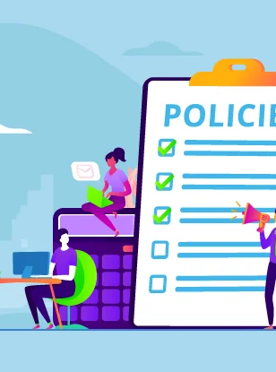
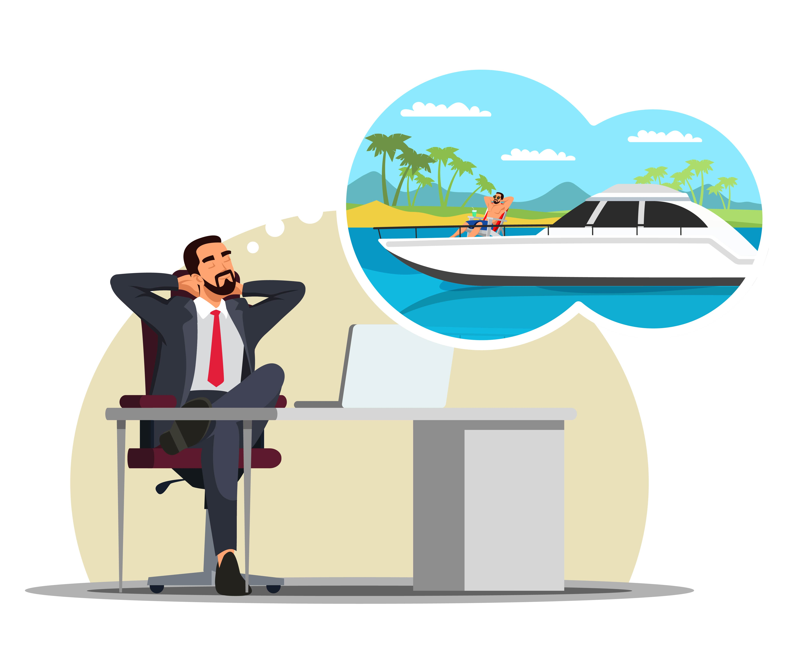


HR Policy Document: Leave Policy
Ensure employees have enough rest and personal time to maintain work-life balance.
Provide clear guidelines on how employees can request and use leave.
Ensure fairness, transparency, and consistency in the approval and management of employee leave.
Dubai
Canada
Japan
About country here
About country here
About country here
Created by: Elham Sadiqi

Slide 2
Types of Leave
Annual Leave:
Full-time employees are allowed to 20 working days of paid annual leave per year.
Unused leave may be carried forward to the next year (up to 10 days).
Created by: Elham Sadiqi

Slide 3
Sick Leave:
Employees are allowed 10 days of paid sick leave per year.
A medical certificate is required for absences exceeding two consecutive days.
Unused sick leave cannot be carried forward.
Created by: Elham Sadiqi

Slide 4
Emergency / Casual Leave
Up to 5 days per year may be taken for personal or family emergencies.
Must be reported to the supervisor as soon as possible.
Created by: Elham Sadiqi

Slide 5
Build your product or service
Create branding and online presence
Launch the first version
Start your business operations
Leave Procedure
01
02
03
04
Request
Approval
Recording
Return to Work
Submit leave through the HR system (or in writing) at least 7 days in advance.
For emergencies, inform your supervisor immediately by phone or email.
Supervisor reviews based on workload; HR checks leave balance and confirms.
Approved leave is logged in the HR system.
Any changes or cancellations must be updated.
Report on the next working day.
For medical leave, provide a fitness certificate if requested.
Created By: Elham Sadiqi

